Slide 1
CHAPTER 7: Advanced Data Step
Day 6

Slide 2
CHAPTER 7: Advanced Data Step
FRIDAY!!!!!!!!
If you made it in today we are going to learn one of the greatest and useful yet unused tricks in a DATA step…and one of the most unknown by beginners.

Slide 3
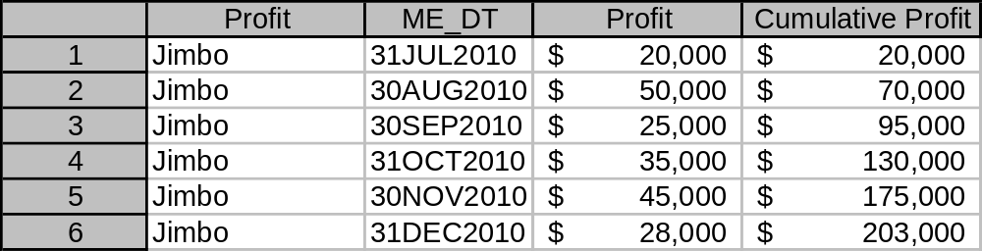
CHAPTER 7: Advanced Data Step
The MIGHTY RETAIN statement!
  Allows you to cumulate in a dataset by ‘retaining’ the value, in this case Profit, from a previous row.

Slide 4
CHAPTER 7: Try on your own 1
First lets create our sample dataset by creating a new dataset called als_subset from your als_all dataset and select only loan “A8118100004814”
data als_subset;
set customer.als_all;
if .... then do;
.......;
end;
run;
Hint!

Slide 5
CHAPTER 7: Try on your own 1
(Solution)
data als_subset;
set customer.als_all;
if acct_umk="A8118100004814" then do;
output;
end;
run;

Slide 6
CHAPTER 7: Advanced Data Step
Now we have our data lets learn what the Retain function looks like.
data dataset_name;
format new_var w.d;
set old_data;
retain new_var 0; /*Retains the previous rows value of new_var and sets the
initial value to 0 */
new_var=new_var + (variable you are cumulating);
run;

Slide 7
CHAPTER 7: Try on your own 2
Now do your own with the dataset als_subset you just created.
  New dataset name: als_cumulate
  New Variable: Cum_balance, set to 0 initially
  Variable you are cumulating: me_balance
Hint!
data dataset_name;
format new_var w.d;
set old_data;
retain new_var 0; /*Retains the previous rows value of new_var and sets the initial value
to 0 */
new_var=new_var + (variable you are cumulating);
run;

Slide 8
CHAPTER 7: Try on your own 2
(Solution)
data als_cumulate;
format cum_balance dollar10.0;
set als_subset;
retain Cum_balance 0;
Cum_balance=Cum_balance + me_balance;
run;

Slide 9
CHAPTER 7: Try on your own 2 (Extension to whole of original dataset)
proc sort data= customer.als_all;
by acct_umk me_dt;
run;
data als_cumulate2;
format cum_balance dollar10.0;
set customer.als_all;
by acct_umk;
if first.acct_umk=1 then do;
cum_balance = me_balance;
end;
else do;
retain cum_balance;
cum_balance=cum_balance + me_balance;
end;
run;

